Slide 1
Disparity estimation based on segmentation
指導教授:丁建均
學生:楊浩學

Slide 2
Outline
Introduction
Segmentation
  ERS and merging
Matching
  Weighted-SAD and Weighted-NCC
  Binary Weighted-SAD and RGB upper limit
Dilation and background limitation
Result
Conclusion

Slide 3
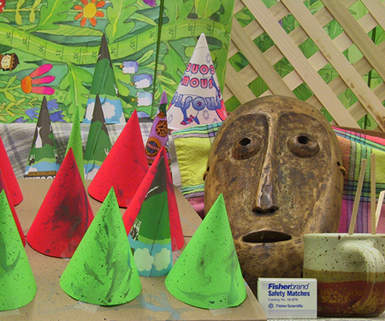
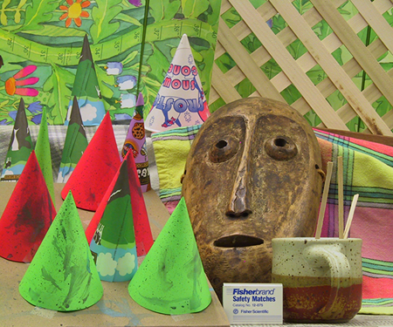
Introduction
Pixels difference between two point of view
Left view(375x450) Right view(375x450)

Slide 4
Introduction
Feature-based and window-based algorithm
Lack of feature points in small image
Choose window-based algorithm

Slide 5
Outline
Introduction
Segmentation
  ERS and merging
Matching
  Weighted-SAD and Weighted-NCC
  Binary Weighted-SAD and RGB upper limit
Dilation and background limitation
Result
Conclusion

Slide 6

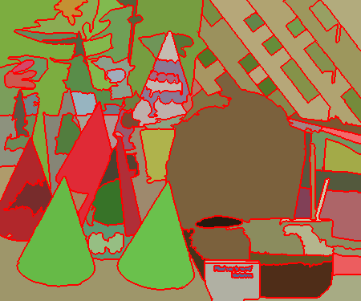
Segmentation
Instead of traditional square-based estimation (3x3,5x5), we choose segmentation estimation
Pixels in same object have similar disparity
Better edge detection and less complexity

Slide 7
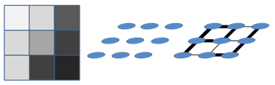
Segmentation
Entropy Rate Superpixel Segmentation(ERS)[1]
  Graph-based segmentation
  Consider each pixel as a node and there are roads between nodes
Wake randomly between pixel and pixel to form a cluster
Notes:
在自然界中, 任何物質會以能達到最大的entropy做移動,所以大氣和熱能會均勻擴散
假設點隨意地在pixels間移動, 移動過程中最大的entropy即是最可能的解
Entropy在segmentation中的定義?

Slide 8
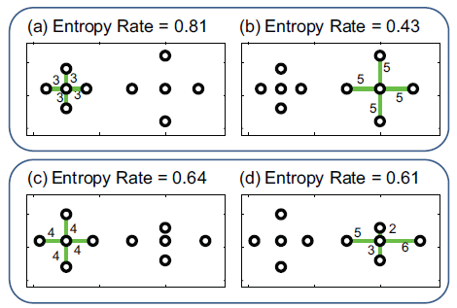
Segmentation
Function:
max H(A)+B(A)
H(A) tends to make homogeneous segmentation
  Similar and average
B(A) tends to make segmentations similar sizes
Irregular shape, changeable superpixels
Notes:
Why we choose ERS:
Irregular shape with similar size
Good object boundary

Slide 9
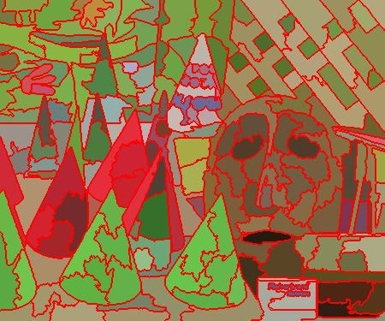
Segmentation
ERS and merging[2]
After experiment, ERS without further merging can reach better result
With merging Without merging
Notes:
Entropy Rate Superpixel Segmentation
Merging能得到和人眼分辨相近的物體切割結果 但對於machine判斷而言 基本的ERS會得到較好的效果
因為同一物體內部也會有不同深度的部分 較細的切割能呈現這一情況(例子:右邊人臉)

Slide 10
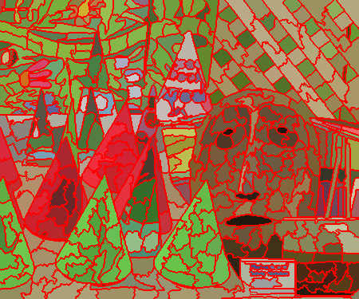
Segmentation
Higher superpixels divide image into more pieces
More accurate but also harder to estimate
200 superpixels 500 superpixels

Slide 11
Outline
Introduction
Segmentation
  ERS and merging
Matching
  Weighted-SAD and Weighted-NCC
  Binary Weighted-SAD and RGB upper limit
Dilation and background limitation
Result
Conclusion

Slide 12
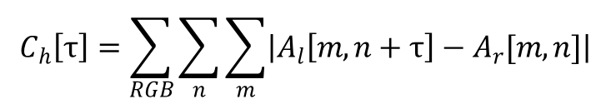
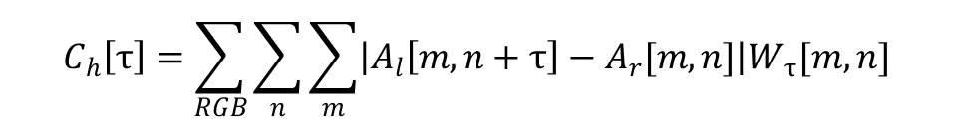
Matching
SAD→ Weighted-SAD(Sum Absolute Difference)[3]
NCC→ Weighted-NCC(Normalized Cross-Correlation)
$$C_{h}\left[τ\right]=\sum_{RGB}{\sum_{n}{\sum_{m}{\left|A_{l}\left[m,n+τ\right]−A_{r}[m,n]\right|}}}$$
$$C_{h}\left[τ\right]=\sum_{RGB}{\sum_{n}{\sum_{m}{\left|A_{l}\left[m,n+τ\right]−A_{r}[m,n]\right|W_{τ}[m,n]}}}$$
$$C_{h}\left[τ\right]=\frac{\sum_{RGB}{\sum_{n}{\sum_{m}{\left(A_{l}\left[m,n+τ\right]−\overline{A_{l}\left[m,n+τ\right]}\right)∗(A_{r}\left[m,n\right]−\overline{A_{r}\left[m,n\right]})}}}}{\sqrt{\sum_{RGB}{\sum_{n}{\sum_{m}{{(A_{l}\left[m,n+τ\right]−\overline{A_{l}\left[m,n+τ\right]})}^{2}}}}}∗\sqrt{\sum_{RGB}{\sum_{n}{\sum_{m}{A_{r}\left[m,n\right]−\overline{A_{r}\left[m,n\right]}}}}}}$$
$$C_{h}\left[τ\right]=NCC∗W_{τ}[m,n]$$

Slide 13
Matching
Edge point is usually more important
more than 1
Notes:
因為edge的資訊較為重要 給予edge的部分較大的weighting
星期三下午5:00

Slide 14
Matching
Occulsion problem
  90% correct with 10% high error vs 90% wrong with low overall error
Notes:
紅色區塊使得整體的判斷錯誤
兩個可能的disparity: 一個是90%區域皆正確 但被少數巨大的錯誤拉高了平均值
另一個是90%區域皆錯誤 但都錯不多導致平均值與前者差不多低

Slide 15
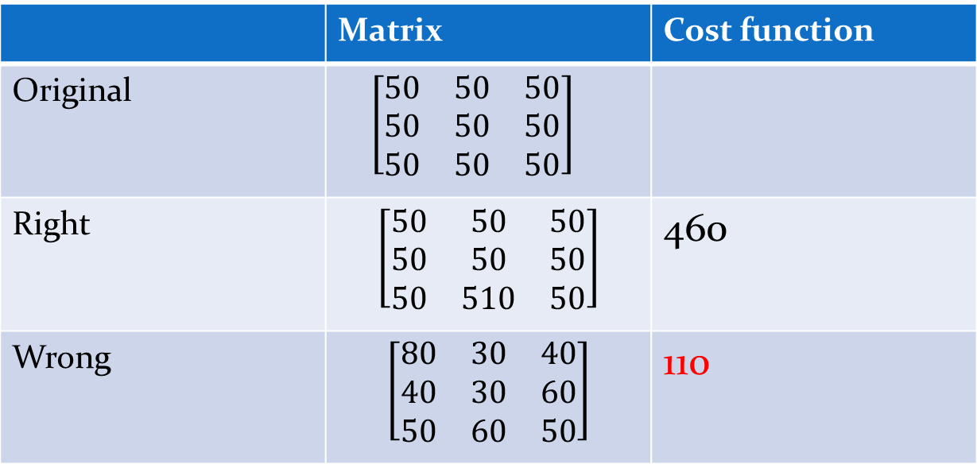
Matching
Example:
 | Matrix | Cost function
Original | $\left[\begin{matrix}50 & 50 & 50 \\ 50 & 50 & 50 \\ 50 & 50 & 50\end{matrix}\right]$
Right | $$\left[\begin{matrix}50 & 50 & 50 \\ 50 & 50 & 50 \\ 50 & 510 & 50\end{matrix}\right]$$ | 460
Wrong | $$\left[\begin{matrix}80 & 30 & 40 \\ 40 & 30 & 60 \\ 50 & 60 & 50\end{matrix}\right]$$ | 110

Slide 16
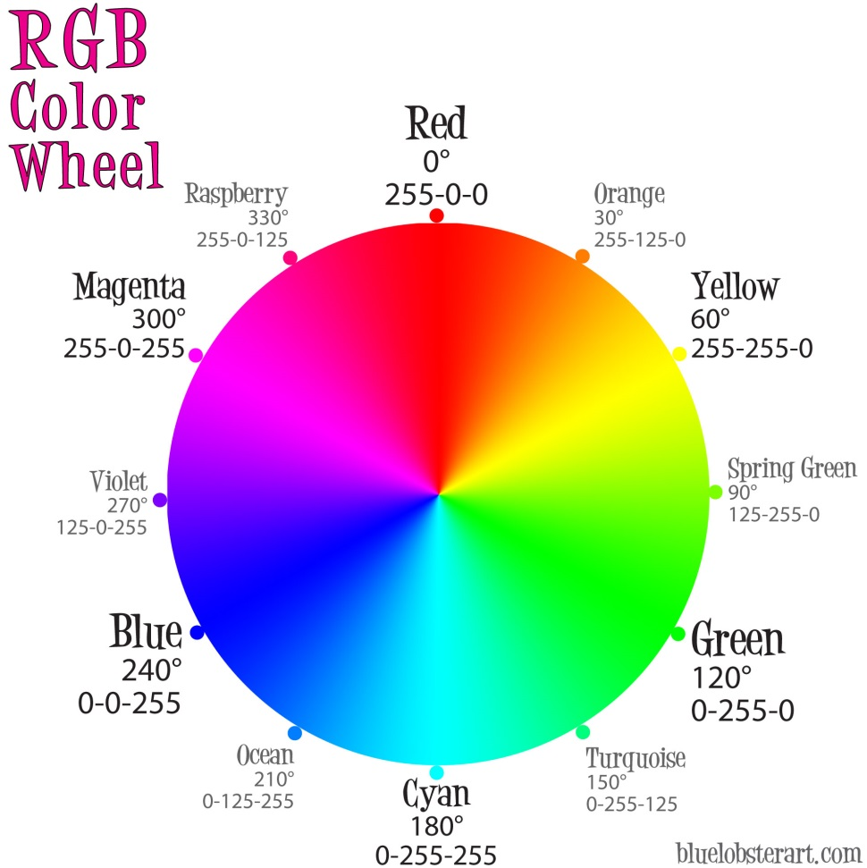
Matching
Solving: RGB upper limit and Binary Weighted-SAD
RGB upper limit: set an upper limit to RGB difference
RGB difference more than upper limit will be set as it
Red vs green: 510→90
Notes:
90

Slide 17
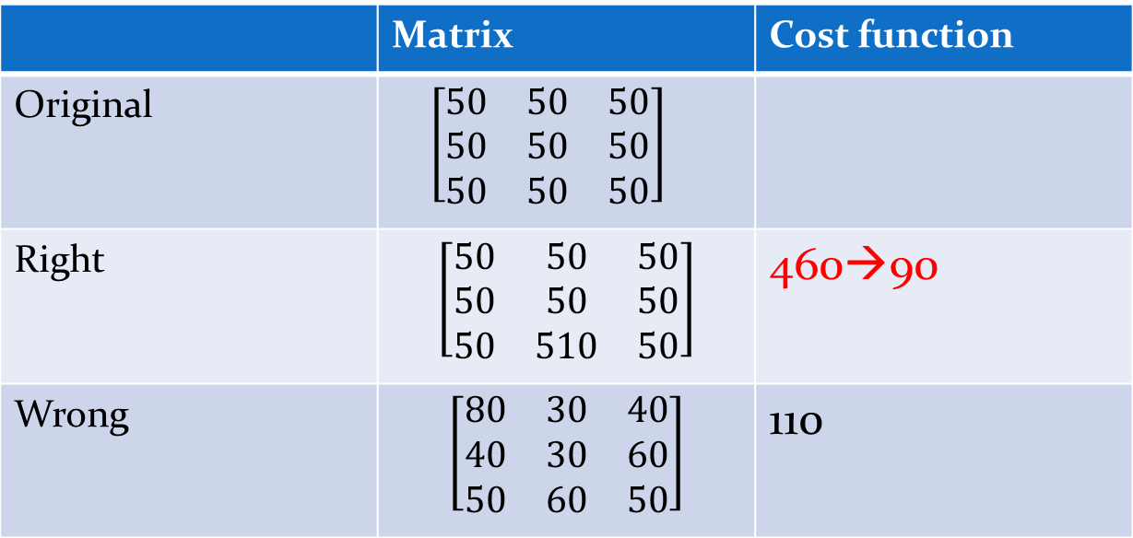
Matching
Example:
 | Matrix | Cost function
Original | $\left[\begin{matrix}50 & 50 & 50 \\ 50 & 50 & 50 \\ 50 & 50 & 50\end{matrix}\right]$
Right | $$\left[\begin{matrix}50 & 50 & 50 \\ 50 & 50 & 50 \\ 50 & 510 & 50\end{matrix}\right]$$ | 460→90
Wrong | $$\left[\begin{matrix}80 & 30 & 40 \\ 40 & 30 & 60 \\ 50 & 60 & 50\end{matrix}\right]$$ | 110

Slide 18
Matching
Binary Weighted-SAD(BWSAD)
Code RGB difference as 0/1, higher than boundary as 1
  Boundary is set to 30
Find correction rate rather than average difference
  No more calculation is needed
Consider both BWSAD and WSAD
Cost function= 0.5*WSAD+0.5*BWSAD
(Cost function>upper limit)→upper limit
Notes:
The correct rate*70

Slide 19
Outline
Introduction
Segmentation
  ERS and merging
Matching
  Weighted-SAD and Weighted-NCC
  Binary Weighted-SAD and RGB upper limit
Dilation and background limitation
Result
Conclusion

Slide 20
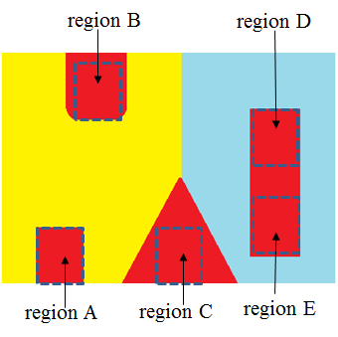
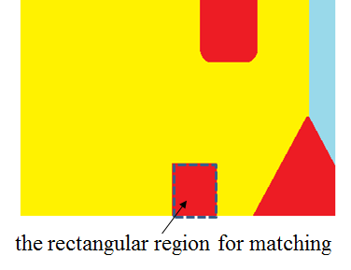
Dilation
Increase matching area to distinguish ambiguous part[5]
Low cost and admirable increase

Slide 21
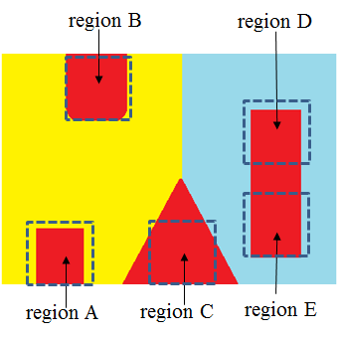
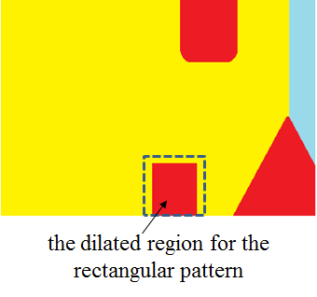
Dilation
Size: 5x5 block, used when object is smaller than 200
Big object has enough information to estimate

Slide 22
Background limitation
Find image background
Since background has lowest disparity, we have smaller searching range for other parts
  Error rate improvement
  Lower searching time

Slide 23
Outline
Introduction
Segmentation
  ERS and merging
Matching
  Weighted-SAD and Weighted-NCC
  Binary Weighted-SAD and RGB upper limit
Dilation and background limitation
Result
Conclusion

Slide 24
Result
200 superpixels with different matching method
Method | Error(more than 1 pixel) | Time(s)
WSAD | 11.19 | 70
WSAD+limit | 8.59 | 75
BWSAD | 9.82 | 73
WSAD+limit+BWSAD | 8.45 | 77

Slide 25
Result
Different superpixels
Superpixels | Error | Time(s)
200 | 8.45% | 77
400 | 5.01% | 157
500 | 4.85% | 197
600 | 5.06% | 251

Slide 26
Result
Plus background limitation
Search gap increase to two
 | Error | Time(s)
Before | 4.85% | 197
After | 4.84% | 150
Gap | Error | Time(s)
1 | 4.85% | 150
2 | 5.59% | 84

Slide 27
Result
The brighter, the closer
Ground truth: the darker,
the more accurate

Slide 28
Outline
Introduction
Segmentation
  ERS and merging
Matching
  Weighted-SAD and Weighted-NCC
  Binary Weighted-SAD and RGB upper limit
Dilation and background limitation
Result
Conclusion

Slide 29
Conclusion
Explain the reason we choose segmentation
Find the most suitable segmentation
Compare different matching method and decide the final method as WSAD+BWSAD+upper limit
Adding dilation and background limitation can further increase the performance

Slide 30
Reference
[1] Entropy Rate Superpixel Segmentation-- Liu, M-Y; Tuzel, O.; Ramalingam, S.; Chellappa, R
[2] High Accuracy and High Robust Natural Image Segmentation Algorithm without Parameter Adjusting-- I-Fan Lu, *Jian-Jiun Ding, and Hsuan-Yi Ko
[3] Image Rendering Techniques and Depth Recovery for Light field Images-- Shih-Chung Chuang, Jian-Jiun Ding
[4] Multilayer Image Disparity Estimation and Blending for Light Field Cameras-- Shih-Chang Chuang, Jian-Jiun Ding *, and Po-Jen Chen
[5] Adaptive Preprocessing and Combination Techniques for
Light Field Image Rendering-- Jian-Jiun Ding and Shih-Chang Chuang
[6] Morphology-Based Disparity Estimation and Rendering Algorithm for Light Field Images-- Jian-Jiun Ding a, Neng-Chien Wang a, Shih-Chang Chuang a, and Ronald Y. Chang b
[7] A Two-Stage Correlation Method for Stereoscopic Depth Estimation-- Nils Einecke and Julian Eggert
[8] http://vision.middlebury.edu/stereo/data/

